Slide 1
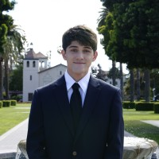
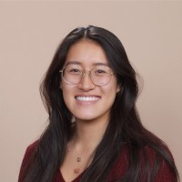
EMG Vocal Translations
Lucas Amlicke
Computer Science & Engr.
Raphael Kusuma
Computer Science & Engr.
Cole Heider
Electrical & Computer Science Engr.
Kayleigh Vu
Computer Science & Engr.
Advisors: Dr. Ahmed Amer, Dr. Maria Kyrarini
Notes:
Kay

Slide 2
Speech Impairment
01
A disorder regarding the articulation of speech sounds, fluency, and/or the voice.
Notes:
Kay

Slide 3
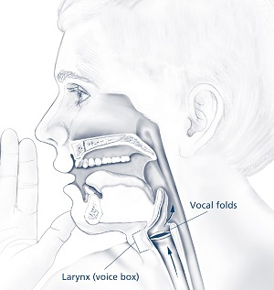
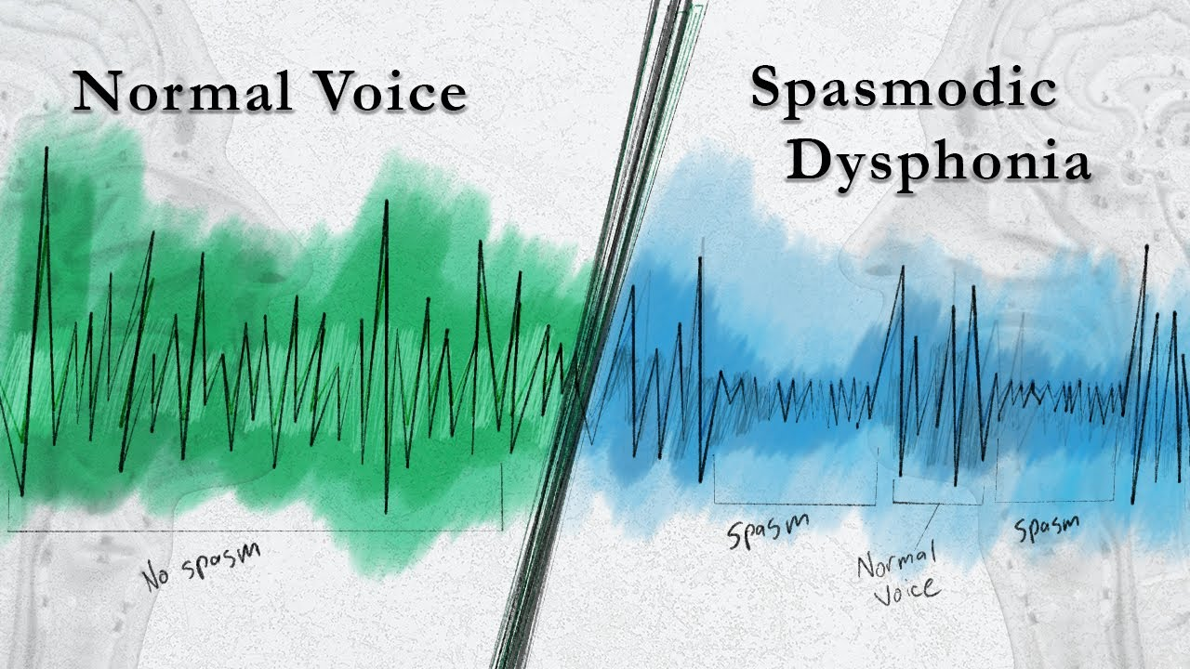
Example: Spasmodic Dysphonia
Notes:
Kay
Spasmodic Dysphonia is one of many disorders in which the muscle in the larynx involuntary spasms, interfering with the vocal folds and chords. This is called a voice tremor.
A real case was a 71-year old patient who was a social worker and family law worker so she was the advocate, the voice for others in need.
She stated that she struggled with participation in conversations, having to spend a lot of time thinking about how she needed to form her sentences but once she thought it out, others have had moved onto another topic
This in turn, affected her quality of life.
She then had to resort to receiving a botox medical procedure once every 4-6 months to help manage the dysphonia.

Slide 4
~11.7%
~77.6%
of adults in United States reported having dysphonia in 2022 [1]
out of 718 S.D. patients surveyed from 1989 to 2014 were female [2]
Sources: [1] American Journal of Speech-Language Pathology, 2024. [2] Mayo Clinic Arizona, SageJournals, 2015.
Notes:
Kay
The American Journal for Speech-Language Pathology found that in 2022, 11.71% of adults in the US reported having dysphonia.
As well as the Mayo Clinic in Arizona found that 77.6% out of 718 spasmodic dysphonia patients surveyed over 25 years were female.
This shows that many studies of the healthcare of underrepresented people in our world are limited. One of many motivations we had to pursue this topic.

Slide 5
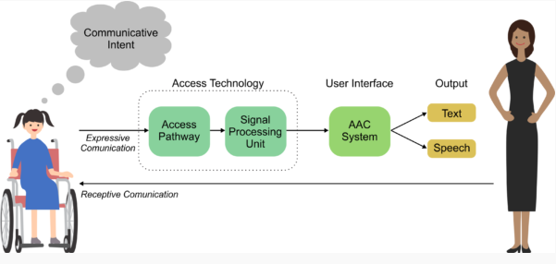
How would you interact/communicate if you could not speak?
Socializing
Opportunities
Independence
Notes:
Kay
Most people include myself take the ability to speak for granted. We don’t think twice about it.
So if we were to put ourselves in the shoes of those with speech impairments, socializing becomes difficult, opportunities may be lost, and well– how could you live on your own terms if you couldn’t advocate for yourself or express what you need? And unfortunately, that’s the reality of those with the impairments.
Diagram:
In the diagram on the right, we see that person A on the left wants to communicate with person B. These days, they would use a communication device or assistive technology to communicate.
In this example, they would use an AAC device (Augmentative and Alternative Communication device) that outputs text and/or speech.
AAC – Augmentative and Alternative Communication devices

Slide 6
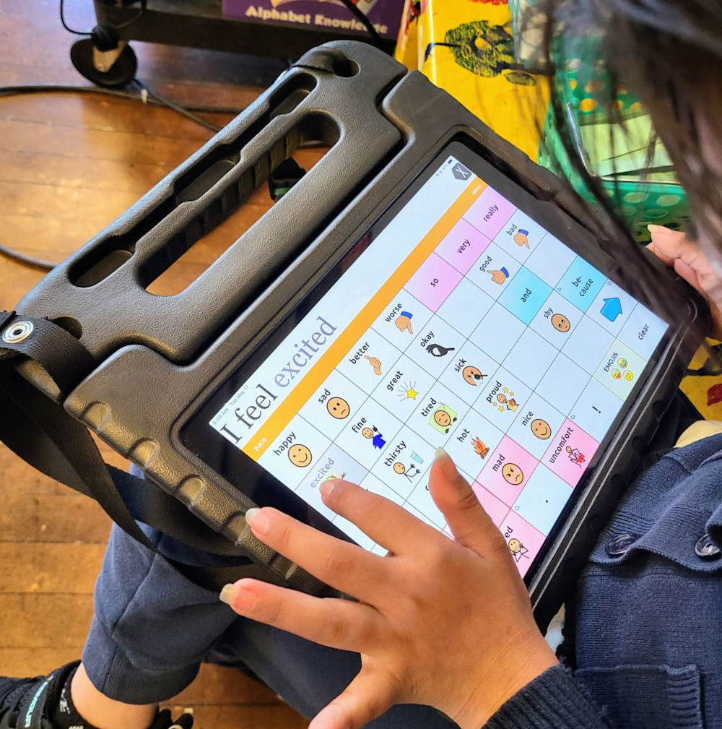
Current solutions
Solution | Cons
AAC Devices | Expensive ($600-$1000) Limited vocabulary
Text-to-Speech Tools | Less natural Requires typing
Medical Procedures & Ultrasound Imaging | Expensive Invasive & Painful
Notes:
Kay
There are other assistive technologies out there such as text-to-speech tools, medical procedures and ultrasound imaging.
However we identified that AAC devices are expensive and limits the user’s vocabulary as the tablets only include words to communicate essential messages.
Medical procedures and ultrasound imaging are also very expensive and produces such as botox are invasive and painful.

Slide 7
Our Solution
02
Giving people their voice back.
Notes:
Kay
So we asked ourselves–can we do better? Can we give the people their voice back?

Slide 8
Subvocalized Silent Speech Device
Subvocalization: the process of silently pronouncing words in one's mind while reading. [3]
Source: [3] International Review of Research in Developmental Disabilities, 2014.
Notes:
Kay

Slide 9
What we aim to provide
Natural
Speech
Bottom-up Approach
Accessible Solution
Recognize attempts at speech through Subvocal Muscular Signals.
By classifying phonetics, we can build up to a large vocabulary.
An affordable setup that is easy to maintain and replicate.
Notes:
Kay
Natural speech – we want our users to naturally communicate with mouth movements, going past the limitations of pressing buttons and typing
Bottom up approach – from the natural speech goal, when classifying the phonetics, we want to build a large english vocabulary for the users, they aren’t limited to just the most commonly used words on a tablet
Accessible solution – lastly, we aim for an affordable setup that is easy to maintain for our users and as this study is limited outside as well, the setup is easy to maintain technologically and can be replicated

Slide 10
Design Considerations
Portability
Reliability
Small, wireless, and comfortable to wear.
High accuracy and ease of maintenance. Affordable components.
Latency
Usability
Easy to use.
Improves quality of life.
Quick to produce speech.
Less than ~200ms for classification.
Notes:
Kay
Portability – we want a small, wireless, and comfortable to wear product for our users to use on a daily basis
Reliability – a system with high accuracy and ease of maintenance with affordable components to ensure the financial affordability for our users.
Lastly, Latency– for producing speech quickly with real-time classifications, we aim to have low latency

Slide 11
Ethical Considerations
Data Confidentiality
Informed consent
Anonymized
Stored securely
No identifiable biometrics
Notes:
Raph

Slide 12
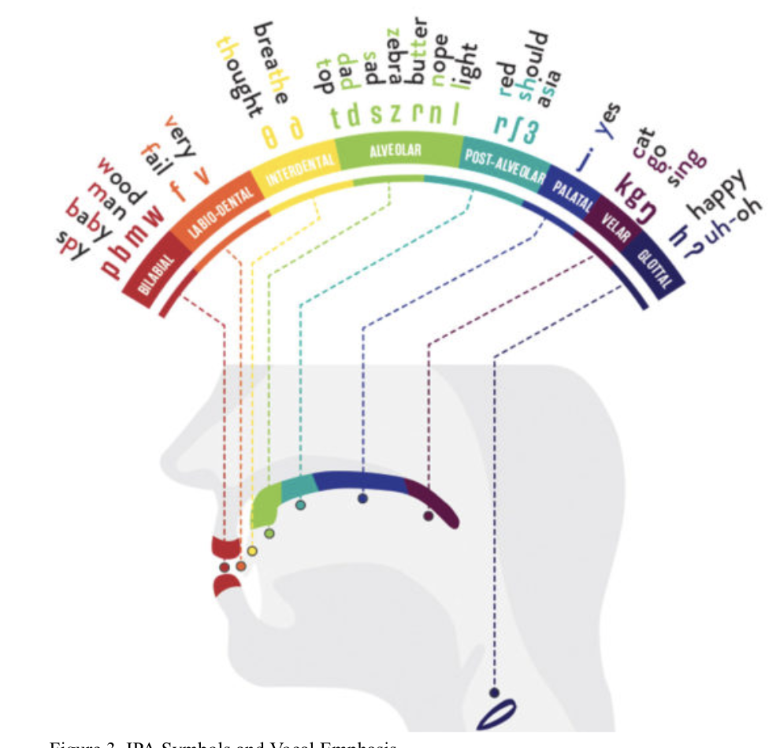
How do we as humans speak?
Speech is made up of small distinguishable noises called phones or phonemes.
39 unique phonemes in the ARPABet
→ label muscle signal data using these classifications
Notes:
Kay
How do we as humans speak?
Speech is made up of small distinguishable noises called phones or phonemes. For example, in “cat” there are 3 phonemes, /k/, /a/, and /t/
There are 39 unique phonemes in the arpabet. The arpabet is a a simplified subset of the ipa (international phonetic alphabet) and of characters for each sound, easier for american english

Slide 13
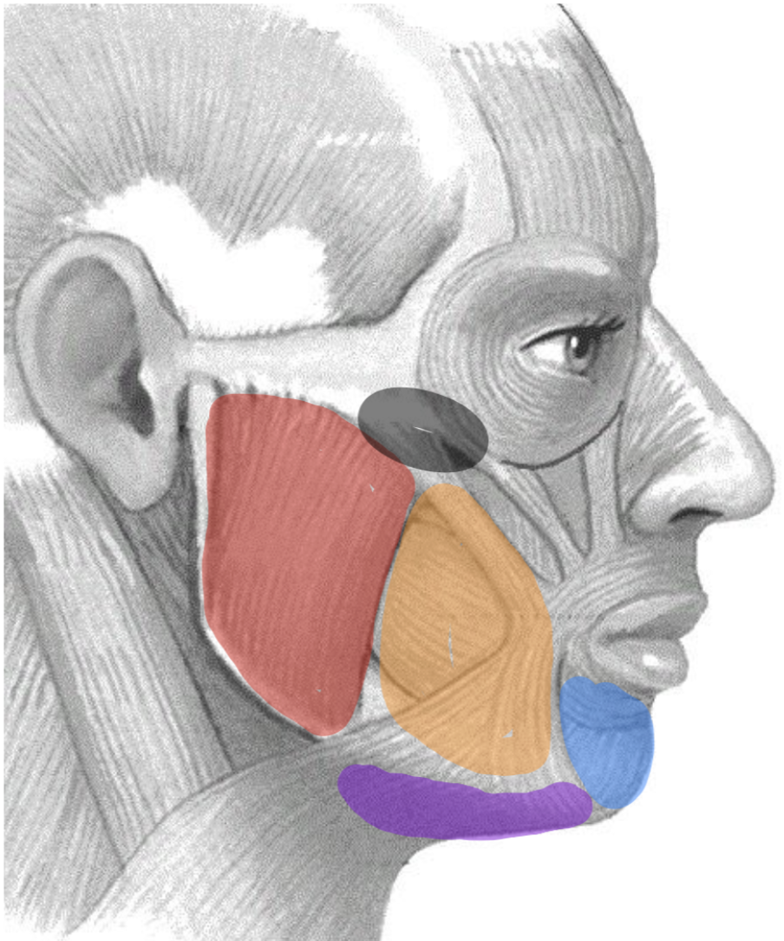
How do we analyze speech?
Simultaneously record audio and muscle signals
→ which muscles create which phoneme
Notes:
Kay
Why did we choose to put 2 electrodes on each facial muscle?
To get the voltage

Slide 14
System Design
03
Notes:
Cole

Slide 15
What is Electromyography (EMG)?
Records the electrical activity produced by the articulatory muscles involved in subvocalization. [4]
Source: [4] AceMap. "Field: 2031856305." DDScholar, ddescholar.acemap.info/field/2031856305.

Slide 16
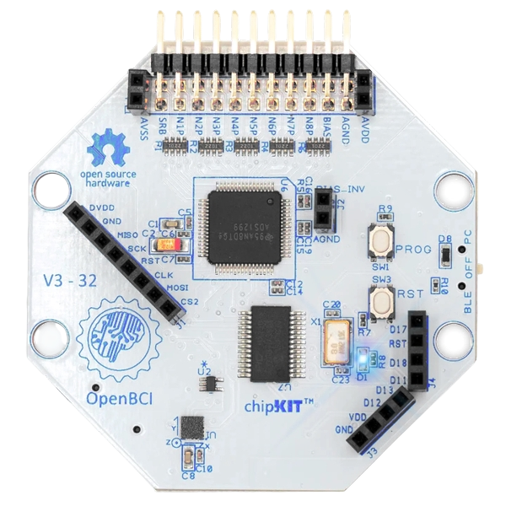
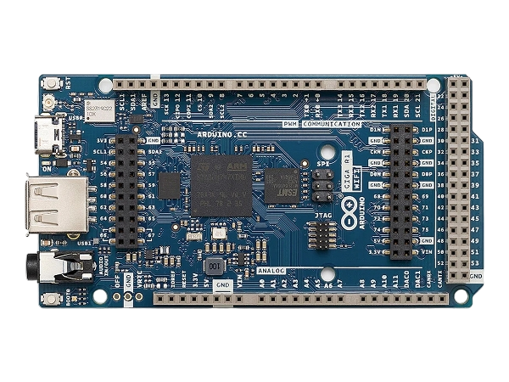
System Overview
Preprocessor
sEMG Data
Processed Data
Feature Extractor
Features
Classifier
Text To Speech
Phonemes
Notes:
Cole

Slide 17
System Overview
Focus of our research - Data Pipeline
Preprocessor
sEMG Data
Processed Data
Feature Extractor
Features
Classifier
Text To Speech
Phonemes
Notes:
Cole

Slide 18
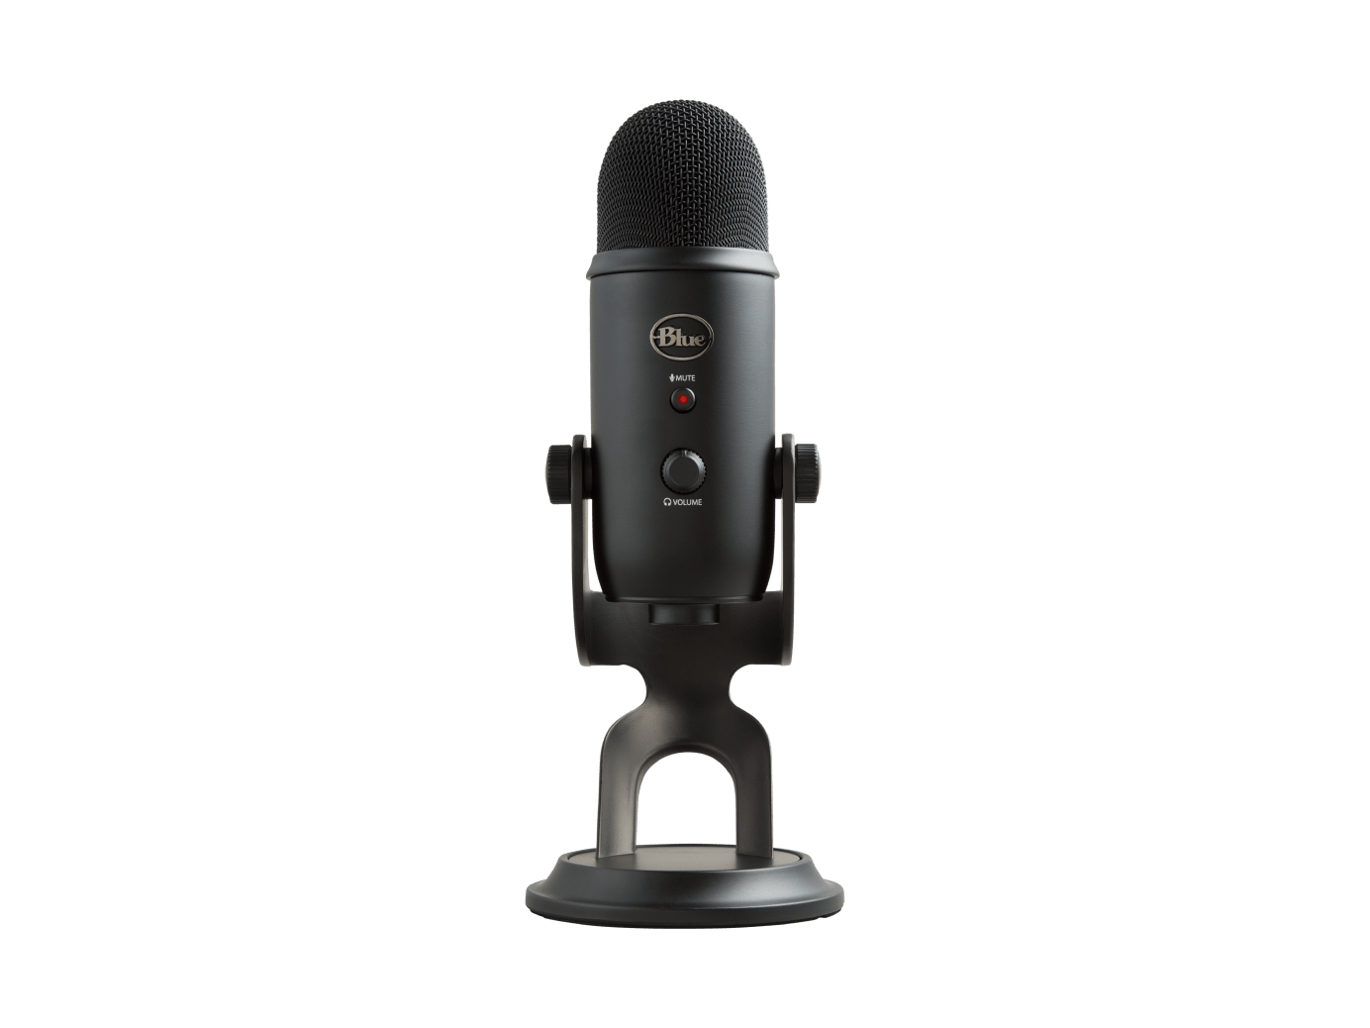
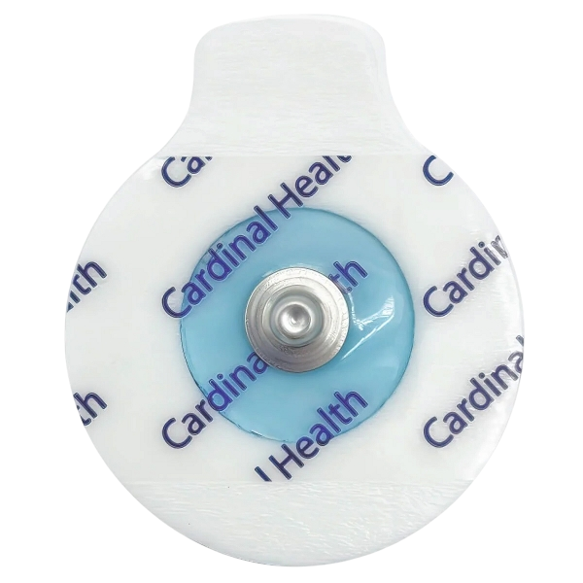
Data Pipeline
Microphone
Labeling
Classifier
Phonemes
Audio Data
Labels
Features
Processed Data
Sensors
EMG Data
Preprocessing
Feature Extractor
Final System
Training Only
Notes:
Cole

Slide 19
Data Pipeline
Microphone
Labeling
Classifier
Phonemes
Audio Data
Labels
Features
Processed Data
Sensors
EMG Data
Preprocessing
Feature Extractor
Final System
Training Only
Notes:
Cole

Slide 20
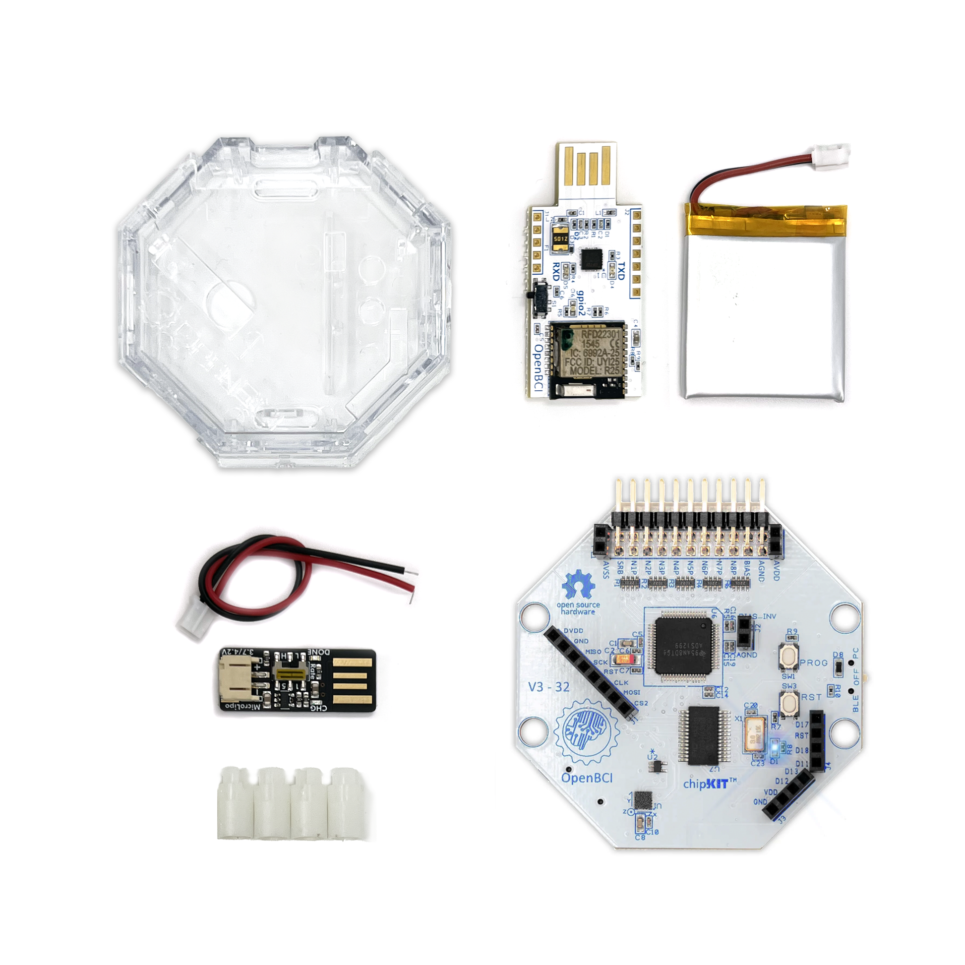
EMG Sensor
The OpenBCI Cyton Biosensing Board
for sampling neuromuscular signals
8 channels
4 channels – Comfort and Portability
250 Hz Sampling Rate
Built-in Microcontroller
Portable (Bluetooth)
Open Source SDKs
Controlling board remotely
Data processing libraries
Notes:
Available data processing libraries (i.e. functions to filter data are built in)
The OpenBCI Cyton Biosensing Board is used for sampling neuromuscular signals.
8 channels
4 channels – Improve comfort and portability.
250 Hz sampling rate
Built-in microcontroller for fast processing speeds
Wireless capabilities through Bluetooth
Battery powered, batteries are rechargeable.
Open Source SDKs
Controlling board remotely
Data processing libraries

Slide 21
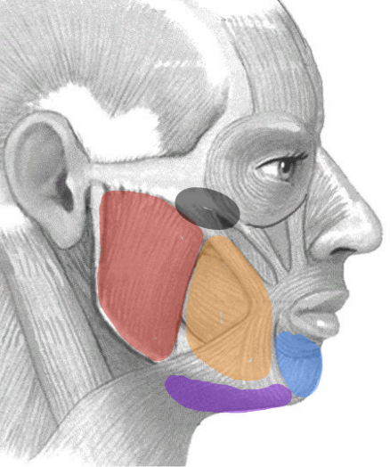
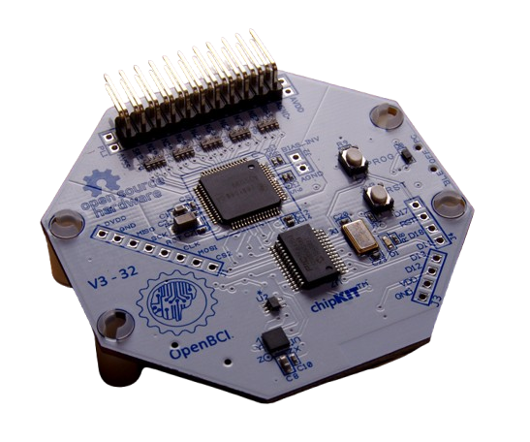
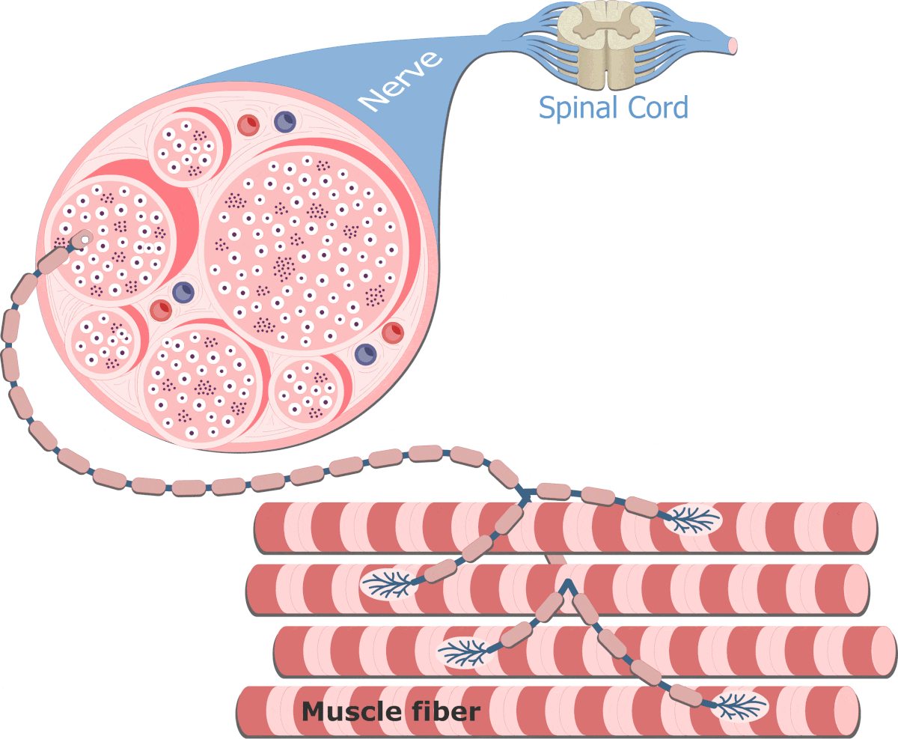
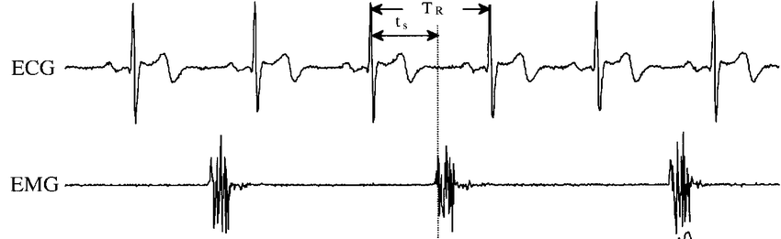
What Do Our Sensors Collect?
Electromyography (EMG)
Measures electrical activity produced by muscle contractions
Surface Electromyography
Non-invasive – sensors on the skin
Sensor: Conductive Gel Electrodes
Jaw, Cheek, Chin, Tongue
Data: Voltage signals (μV) which represent muscle activation during speech
Notes:
Data:
Our sensor amplifies electrical signals under the skin and records the voltage.
We record voltage from muscle regions to find which muscles are active while speaking

Slide 22
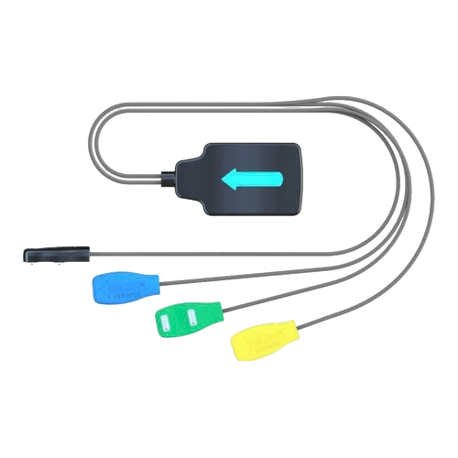
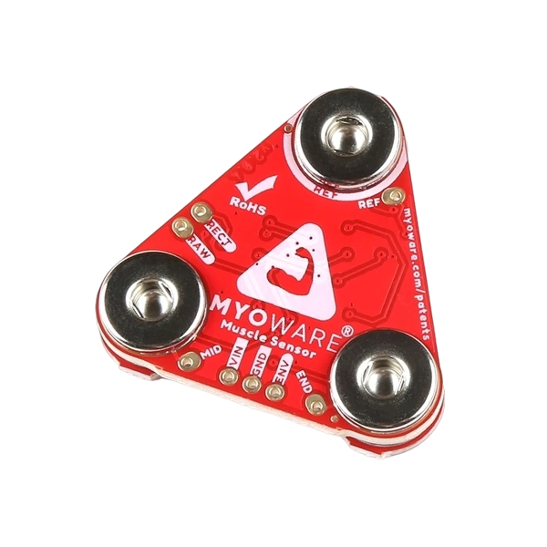
What were the alternatives?
Criteria | OpenBCI Cyton | Delsys Quattro | SparkFun Myoware
Cost | $999 | $3800 | $40
Real-Time Processing | Yes | Yes | No
Sampling Rate | 250 Hz | 2222 Hz | 200 Hz
# of Channels | 8 | 4 | 1
SDK Availability | Available | Available | N/a
Connectivity | Bluetooth | Bluetooth | Wired

Slide 23
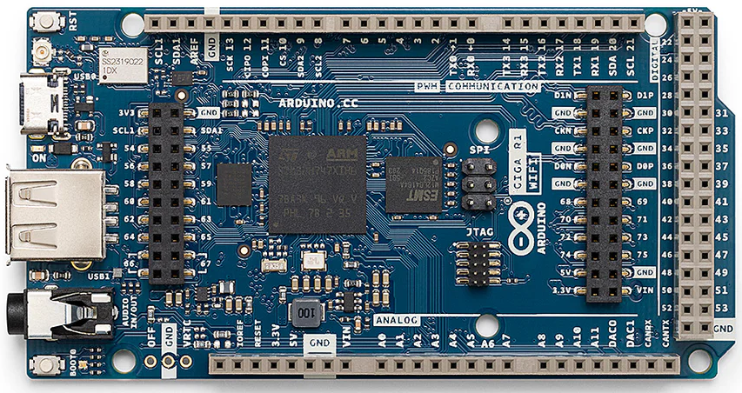
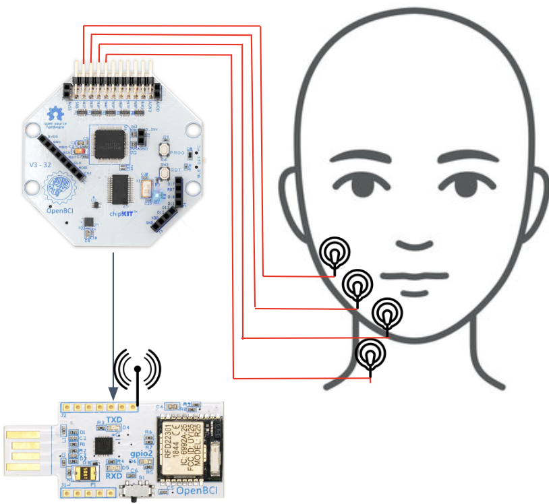
Other Components
Arduino GIGA Microcontroller (1)
Capable Processing Power
Sufficient Storage
WiFi and Bluetooth Capabilities
Highly Portable
Gel Electrodes + Cables
Low-cost ($20 for 50 – 40¢ each)
Small size
Connects electrodes to sensor
(1) Arduino GIGA Microcontroller
Blue Yeti Microphone (2)
High-Quality Audio Recordings
Better Training Data
(2) Blue Yeti Microphone
Notes:
Cole

Slide 24
How can we trust our data?
Standards!
ISO
IEEE
ISO 9241-171
Ergonomics of human-system interaction -- Part 171
ISO 13485
Medical devices — Quality management systems — Requirements for regulatory purposes.
ISO 14971
Medical devices—Application of risk management to medical devices
ISO 14155
Clinical investigation of medical devices for human subjects
IEEE 802.15.1
Local and metropolitan area networks - Part 15.1: Wireless Body Area Networks
IEEE 11073
Health informatics—Personal health device communication
IEEE 12207
Health informatics—Personal health device communication
Notes:
Raph

Slide 25
Data Pipeline
Microphone
Labeling
Classifier
Phonemes
Audio Data
Labels
Features
Processed Data
Sensors
EMG Data
Preprocessing
Feature Extractor
Final System
Training Only
Notes:
Cole

Slide 26
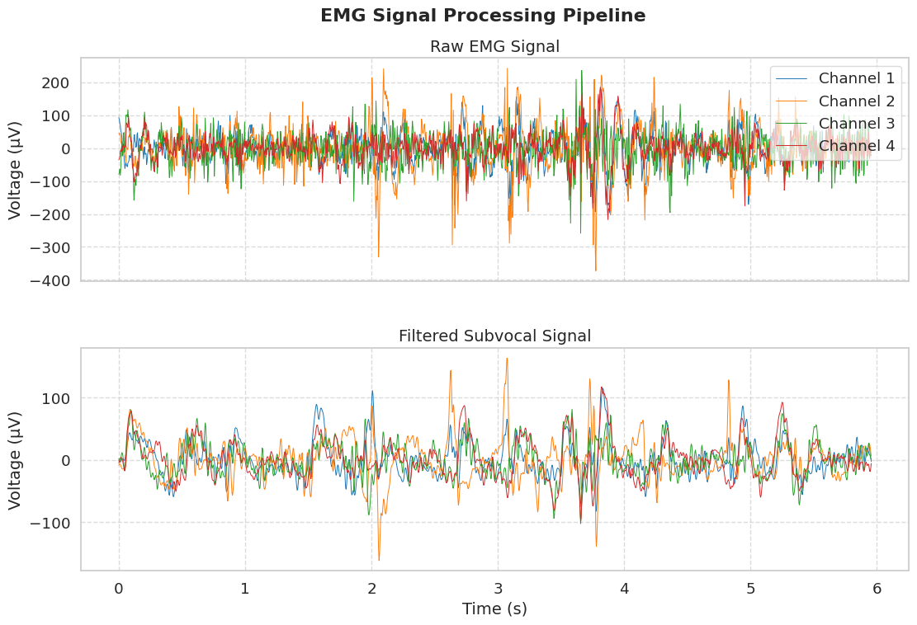
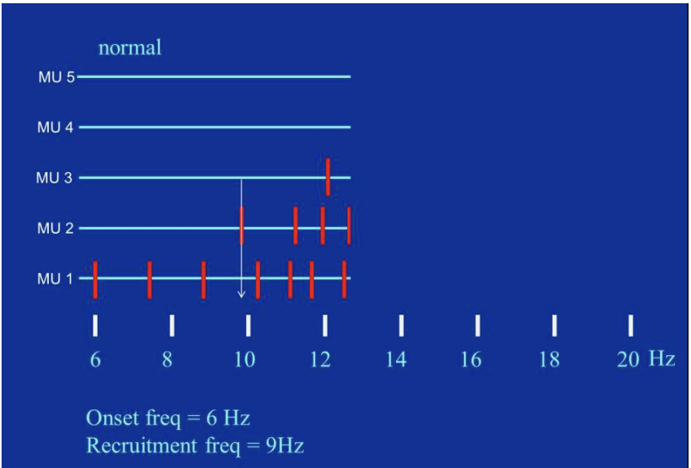
How do we clean data for feature extraction?
sEMG data is processed to remove noise and target specific frequencies
Focus: Subvocal Neuron Activations
Pre-muscle recruitment (1-30 Hz)
Removes high frequency components from nearby devices
Stålberg, 2015
Notes:
Cole

Slide 27
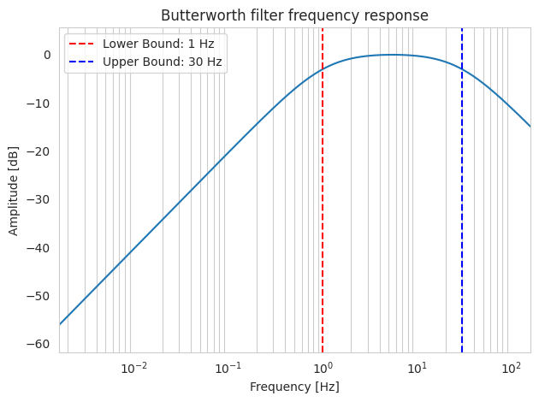
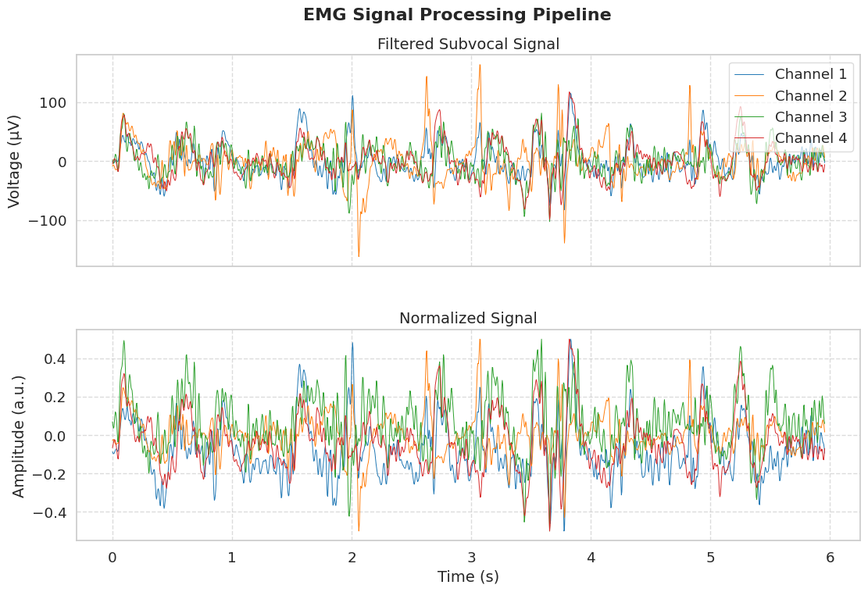
Our Preprocessing Technique
Butterworth Bandpass Filter (1 - 30Hz)
Maximally flat response
High and low cutoff
Create clean signal
Normalization: Ensure all data fits within same value range
Within -0.5 and 0.5 for feature extraction
Notes:
Cole

Slide 28
Data Pipeline
Microphone
Labeling
Classifier
Phonemes
Audio Data
Labels
Features
Processed Data
Sensors
EMG Data
Preprocessing
Feature Extractor
Final System
Training Only
Notes:
Cole

Slide 29
Labeling: Turning speech into data
ARPAbet
Alphabet of human sounds
Records participants speaking prompts
Charsiu
Pre-trained model for time-aligned intervals
When and which phoneme was spoken
Allows labelling
of sEMG data
Notes:
Lucas

Slide 30
Data Pipeline
Microphone
Labeling
Classifier
Phonemes
Audio Data
Labels
Features
Processed Data
Sensors
EMG Data
Preprocessing
Feature Extractor
Final System
Training Only
Notes:
Lucas

Slide 31
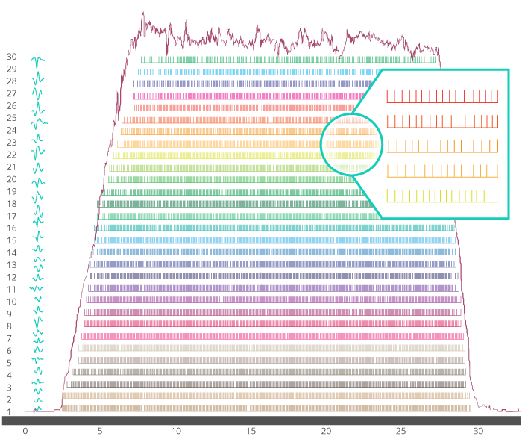
What is in the signal?
Motor Unit Action Potential (MUAP)
Voltage from the collective MUAP produced by all recruited Motor Units
Motor Unit Recruitment Frequency
Rate at which neighbouring neurons are recruited
Notes:
Lucas

Slide 32
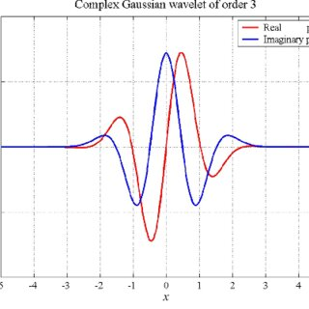
How do we estimate what is below the signal?
Continuous Wavelet Transform
Ruler for measuring Time and Frequency domain
Muscle Activity Approximation
Twitch: High Frequency, Low Energy
Pulse: Pre-contraction
Tension: Prolonged muscle activation
Notes:
Lucas

Slide 33
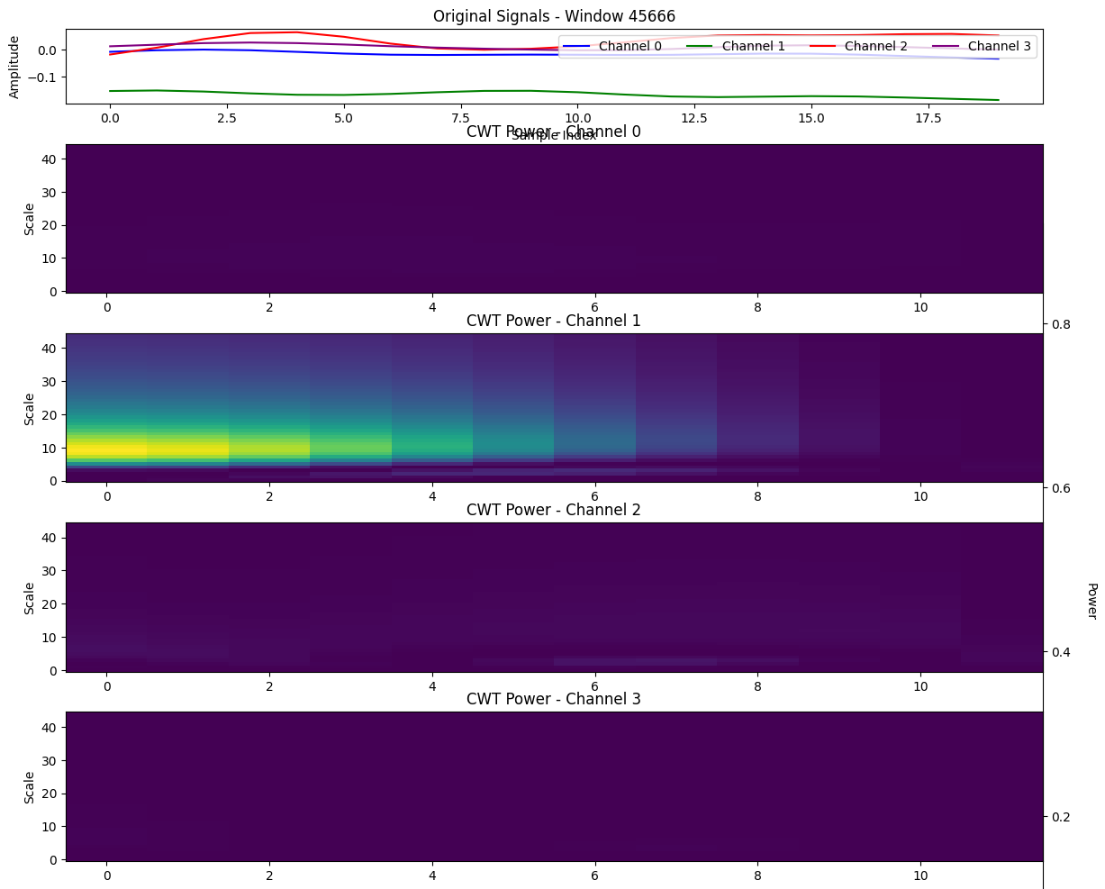
Feature Extraction
Energy/Frequency
Activation Frequency Bands
Peak Magnitude
Activation Strength
Dominant Sub-Frequency
Localized activation frequency
Turns
Amount of signal peaks and valleys
Notes:
Lucas

Slide 34
Data Pipeline
Microphone
Labeling
Classifier
Phonemes
Audio Data
Labels
Features
Processed Data
Sensors
EMG Data
Preprocessing
Feature Extractor
Final System
Training Only
Notes:
Cole

Slide 35
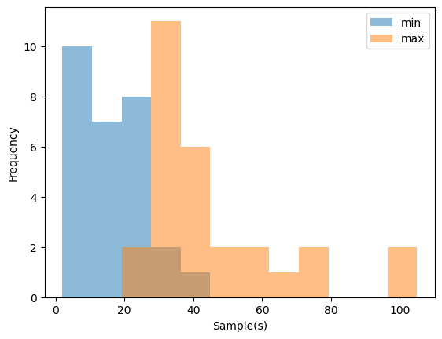
The Classification Task (Phonemes)
Classifying phonemes is a granular precision task
Limitations:
250 Hz sampling rate (0.008-0.4 sec)
4 channels
Phoneme Length Distribution
Notes:
Lucas

Slide 36
The Classification Task (Phonemes)
Echo State Network
(ESN)
Long Short-Term Memory
(LSTM)
Convolutional Neural Network (CNN)
Notes:
Lucas
Algorithms:
Echo State Network
LSTM
GMM/HMM
Random Forest
Gradient Boosting
Spatiotemporal Neural Network
CNN

Slide 37
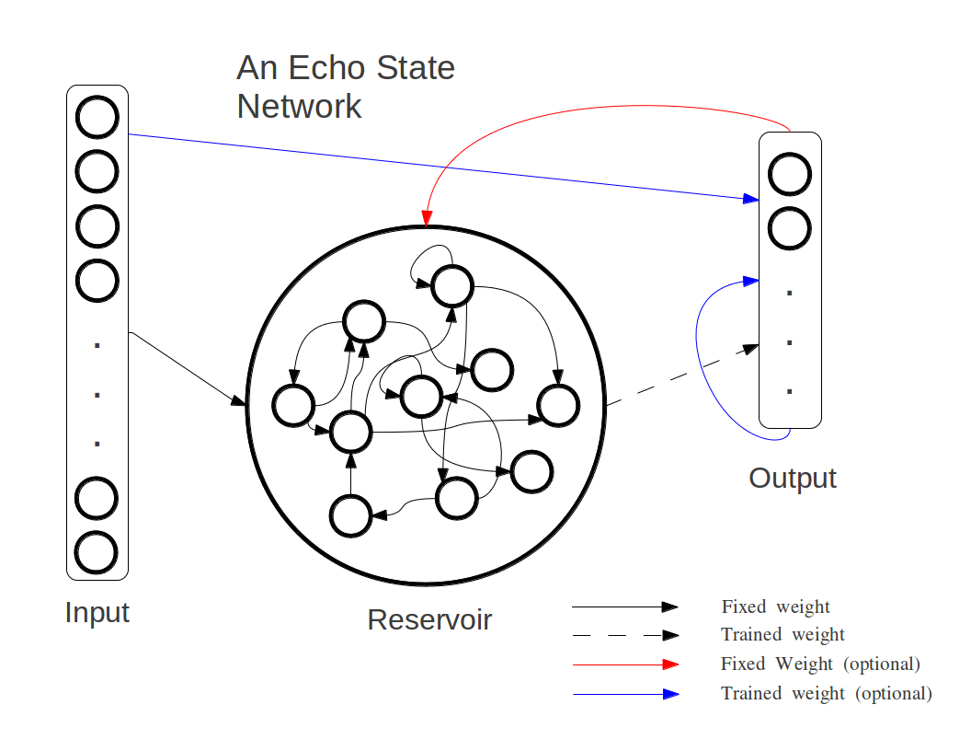
Echo State Neural Network
Reservoir Computing → static weights
Hidden layer = Sparse Graph
Fixed
Echo state property
Only the output layer is trained
Why did we choose this network?
Efficient computation
Recurring “memory” effects
Time-series tasks
Notes:
Lucas

Slide 38
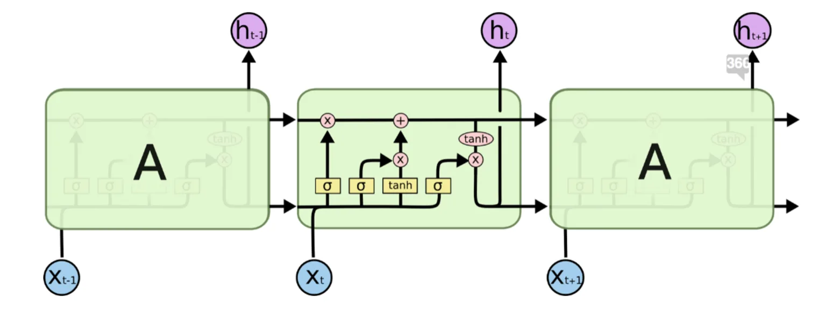
Long Short-Term Memory
Type of RNN
Retains long term dependencies
Popular for speech recognition (ASR)
Cross-Entropy Loss Function
Minimizes the classification error
p = probability distribution (one-shot)
Notes:
Lucas

Slide 39
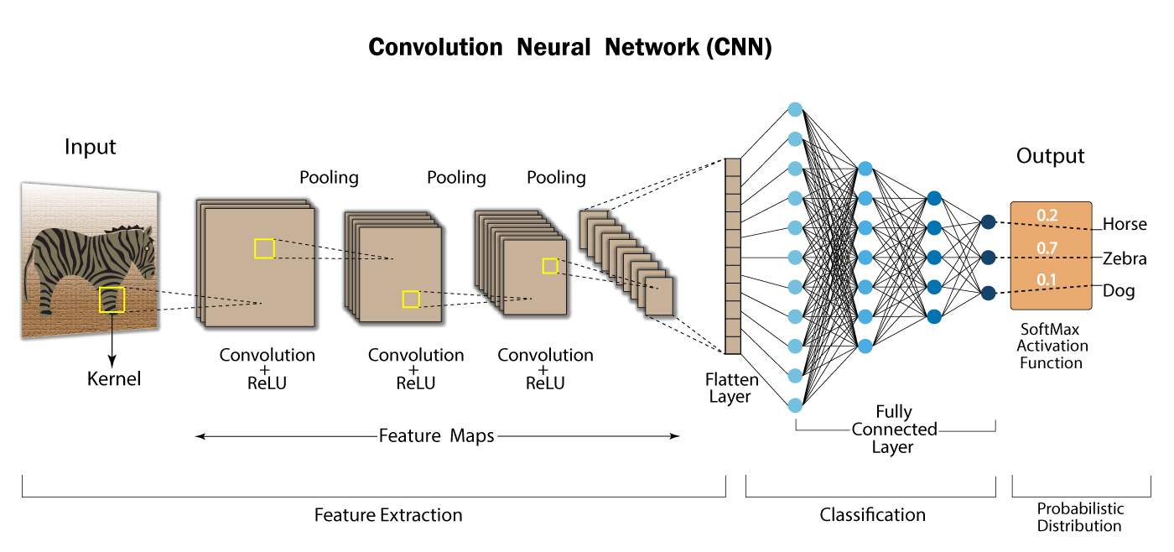
Convolutional Neural Network
STNN = CNN + RNN
Reduces 2-D matrix into unique features
Retains Time-Frequency relationship from Wavelet Transform
Notes:
Lucas

Slide 40
Data Collection
04
Collected data from a wide range of volunteers to train the ML model.
Notes:
Raphael
Alrighty, so now I’m going to talk about our data collection procedures.

Slide 41
IRB
Volunteers
Procedure
Prompts
Data
IRB approval ensures that our research meets ethical standards and regulatory requirements
Research involving human subjects
Training and Certifications
Participants
Informed Consent
Collected biometric data
Anonymized
Stored Securely
Protocol ID: 25-01-2300
Under requirements set by: Santa Clara University
Notes:
Raphael
To find our volunteers, we created posters that were sent digitally and posted around the Engineering building. We provided incentives such as free refreshments, and people are able to scan a QR code, fill in a Google form and then book a time slot. The google form was used to filter out participants who would not be a good fit. An example would be those with silver allergies, as our electrode contacts are made of silver, or if they have facial hair, as facial hair would mess up our readings as they act as a barrier between the skin and the gel electrodes. The form has an overview of the project, the process, and what their data is used for. The poster also describes what we’re doing with their data too.

Slide 42
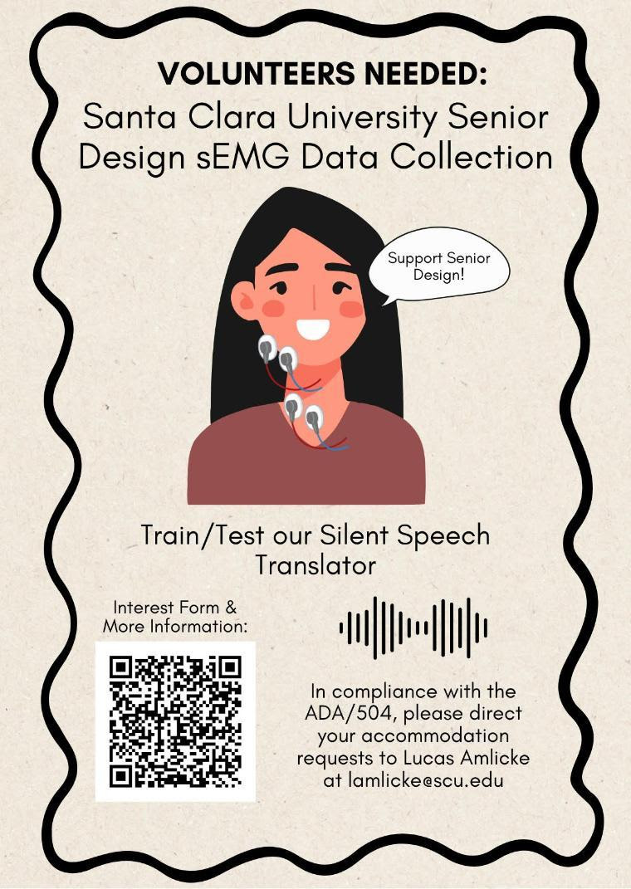
IRB
Volunteers
Procedure
Prompts
Data
Flyer
Google Form
Participant Criteria
No Allergies
No Facial hair
English Fluency
Overview
Voluntary Participation
Data Usage Privacy
Notes:
Raphael
To find our volunteers, we created posters that were sent digitally and posted around the Engineering building. We provided incentives such as free refreshments, and people are able to scan a QR code, fill in a Google form and then book a time slot. The google form was used to filter out participants who would not be a good fit. An example would be those with silver allergies, as our electrode contacts are made of silver, or if they have facial hair, as facial hair would mess up our readings as they act as a barrier between the skin and the gel electrodes. The form has an overview of the project, the process, and what their data is used for. The poster also describes what we’re doing with their data too.

Slide 43
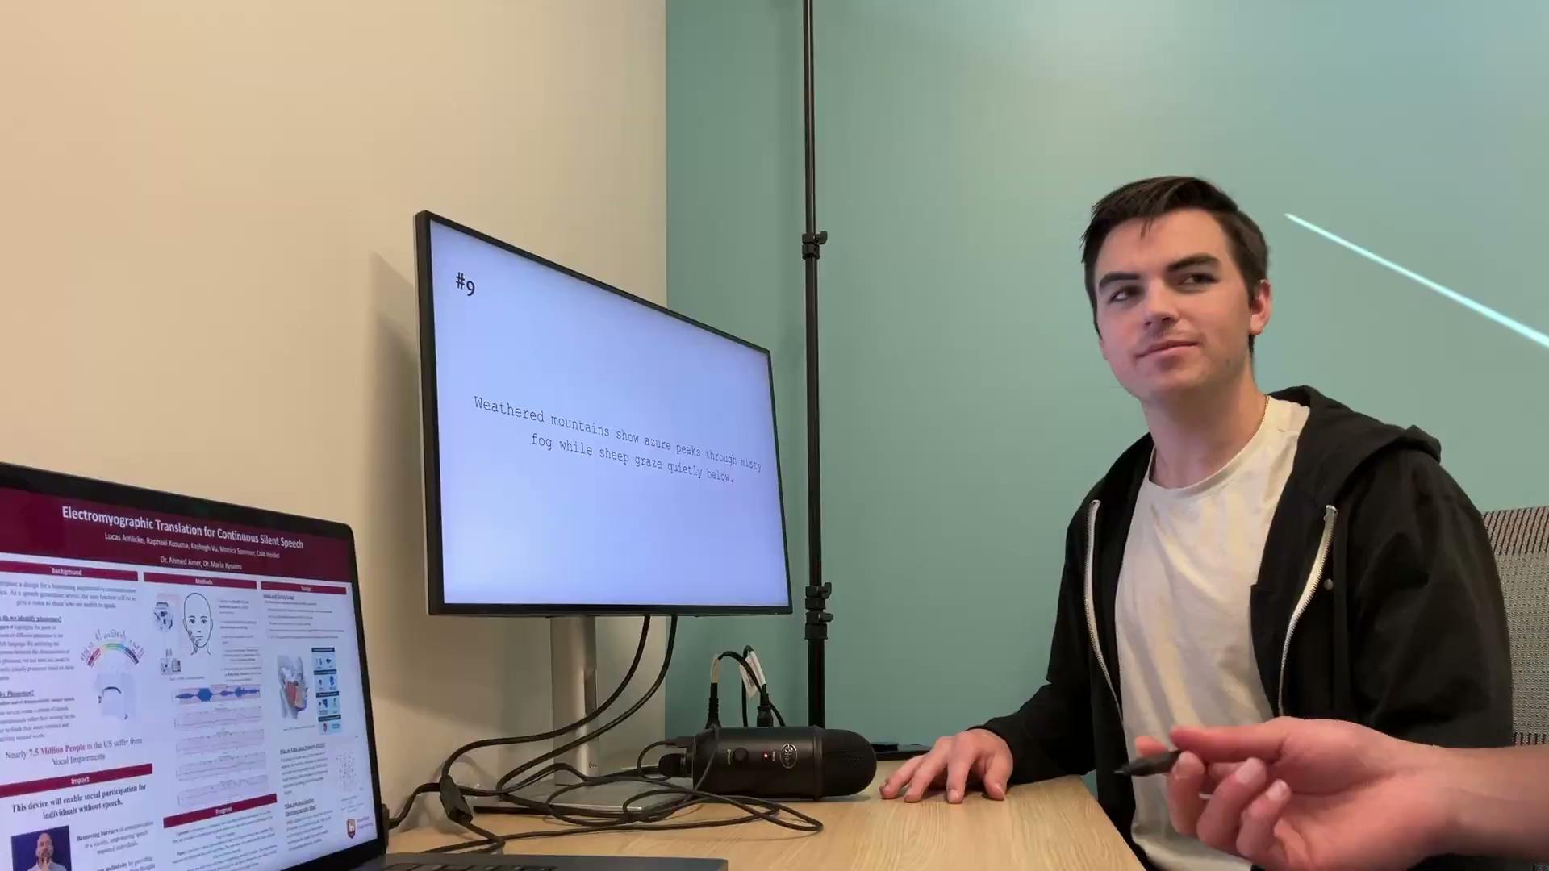
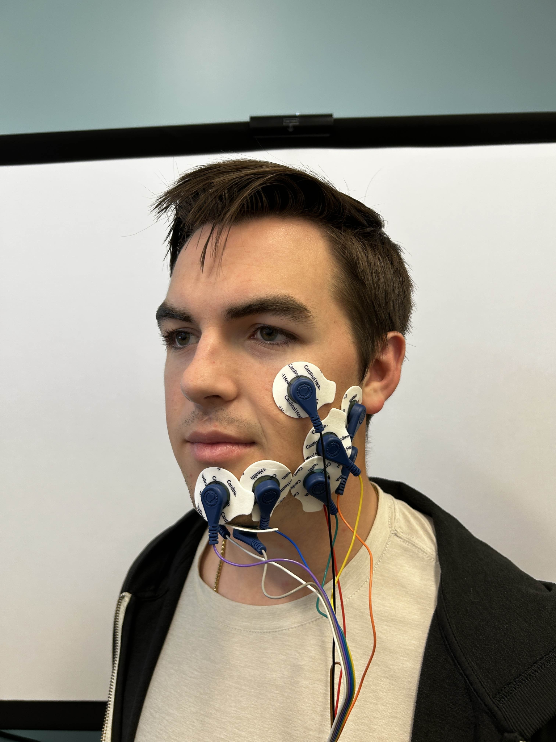
IRB
Volunteers
Procedure
Prompts
Data
Notes:
OpenBCI GUI application to visually observe signals

Slide 44
IRB
Volunteers
Procedure
Prompts
Data
“
”
Weathered mountains show azure peaks through misty fog while sheep graze quietly below.
Why did we choose our prompts?
Phoneme Diversity → covers all the phonemes in the English language.
Contains 31 of all 39 phonemes
[SIL] W EH DH ER D M AW N T AH Z SH OW AE ZH P IY K S TH R UW IH F AA G AY L EY B
Notes:
Raphael
Initially we had 15 prompts, we then expanded this to 50 to get more data out of one individual sign up. We chose our prompts strategically to ensure we get all the phonemes in the ARPAbet. Later on, we though harder about balancing the phonemes so that we get a good amount of observations on each label.

Slide 45
IRB
Volunteers
Procedure
Prompts
Data
~2 Hrs of Data: About 540 labeled files of audio and sEMG data
Participants are fluent in English
Ages: 18+
Higher proportion of volunteers being males
Initially: 16 Participants recited 15 prompts (flat entropy of phonemes)
Change: 6 Participants recited 50 prompts with balanced set of phonemes
Notes:
Raphael
The result of that was 650 files of sEMG and audio files. In total we have 65 different prompts. Again, we Initially had participants recite 15 prompts, but we noticed that we needed a lot more data, so to deal with the low sign-ups we decided to up the prompts to 50. We have data from 4 channels of sEMGs and audio data.

Slide 46
Results
05
What did we obtain?
Notes:
Raph

Slide 47
Results
 | CNN | LSTM | STNN
F1 | 30% | 22.7% | 27%
30% F1-score with all 39 classes
Indication of an underlying structure between sEMG data and phonetics
To establish a correlation: We need more data.
Notes:
Currently, we’re still developing our model. Our ability to work on the real-time classification task is blocked until our model performs at an acceptable level. With 39 classes (all the phonemes in the ARPABet) we were at most able to achieve a 30% F1 Score, so it would realistically be able to predict 30% of windows properly. Much better than random guessing! We’re still working on testing correlation between current and new features to our classes, in addition to collecting test data to improve our accuracy.
We do understand that our classifier’s performance leaves much to be desired. However, we managed to demonstrate a correlation between the features extracted from windows of sEMG signals to phonetic symbols with limited hardware and a small dataset. This is a proof of concept that lays the groundwork for the validity of sEMG based non-invasive and affordable silent speech interfaces, in which we give the vocally impaired a voice.
Our classifier shows promise. We managed to demonstrate a correlation between sEMG signals and phoneme utterances with limited resources. This shows that it is possible to give voices back to the vocally impaired.

Slide 48
Challenges
06
What hurdles were experienced?
Notes:
Now I’m gonna talk about some of the challenges we faced. There’s not too much documentation on phonetic classification using sEMGs, so we knew that we were going to face some problems throughout the process.

Slide 49
Challenges
Volume of Data Collected
1
Low volume of data
Difficulty getting volunteer sign-ups
Manual Data Labeling
2
Inefficient & Inaccurate
Found: Pre-Trained Model
Hardware
3
Constrained to 250 Hz
Notes:
Since this project centers around machine learning, one of the core requirements was good, plentiful data. To start off, we struggled to collect a suitable amount of data. If we wanted to fully assess if our ML algorithms are working as expected, then we would need more data to fully see where our deficiencies are. Next was data labeling. Initially, we had plans to manually label the data. One approach with sEMGs is to create a large amount of noise at the start, and use those signals as a frame of reference. Fortunately, we were able to find a pre-trained model capable of aligning prompts to audio data accurately. We checked the suitability qualitatively and determined that it was acceptable to use. Then by using the open source SDK to interface with our Cyton Board, we could also align the sEMG data with the audio recordings. Simplifying the process further.
Hardware also contributed to this. Utilizing more channels and a higher sampling rate would’ve provided higher quality data that we could extract more information from.

Slide 50
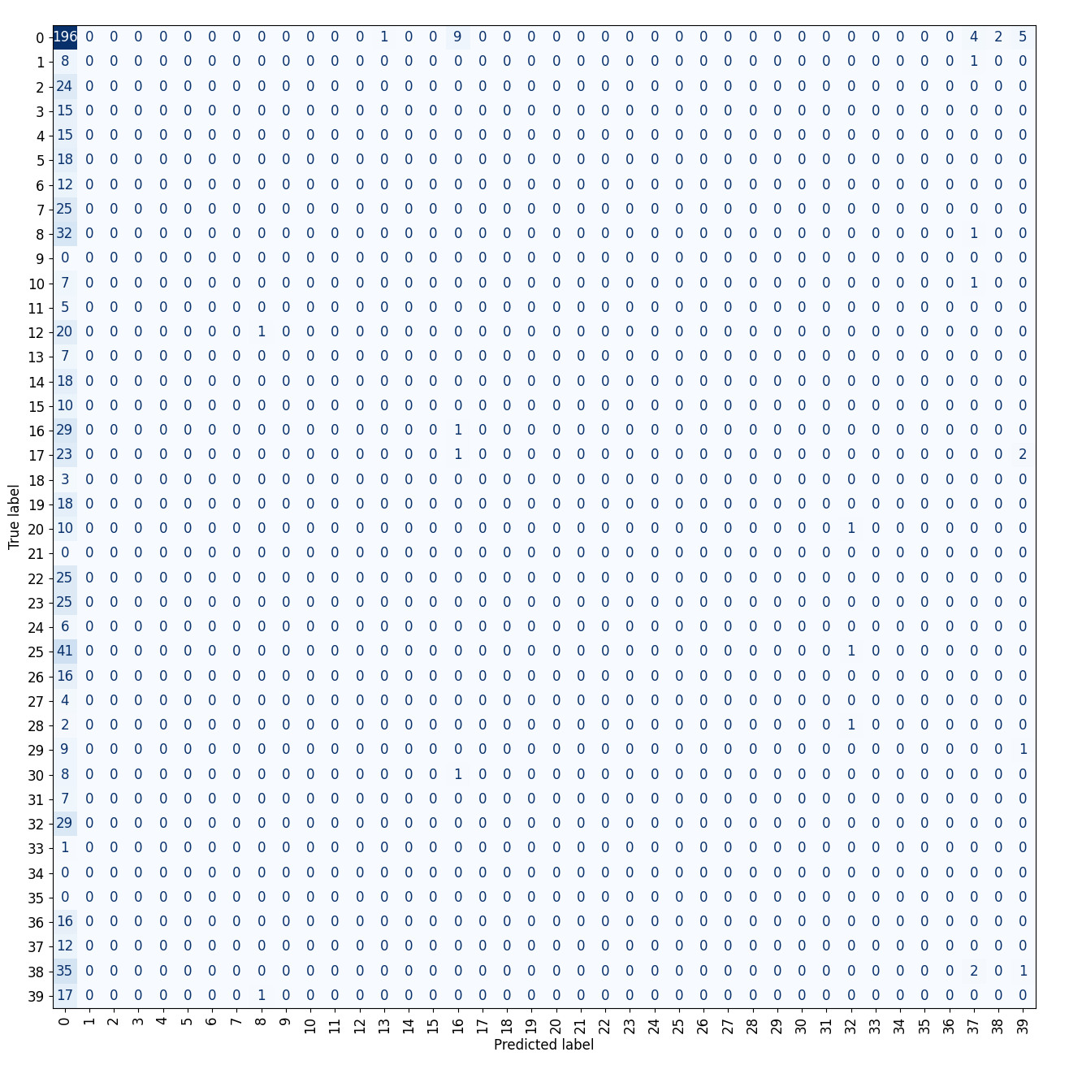
Overfitting on Silence
Model constantly overfitting on silence
High Number of Silence: Natural pauses between words (beginning and end)
To overcome challenge:
→ Normalized Weights
→ Data Undersampling
Notes:
Raphael
We kept noticing a common problem in all our models. It seemed that our model was constantly overfitting on silence. This should’ve been expected since every prompt recited will have silence, but may not have all the phonetic symbols. To overcome this hurdle, we experimented with normalized weights and data augmentation. What that means is that we punished our model with standardized amounts to ensure that labels with less supports are still kept relevant. Data augmentation means that we’re cutting out silence to balance it out with the rest of the dataset. We also attempted additional feature extraction methods because we noticed that upon conducting feature correlation, we noticed that all our features correlated with silence.
This is because we naturally have a lot of samples of silence in each test.
To overcome this, we experimented with normalized weights.
Punishes the model for misclassifying silence.
We also attempted to undersample our data, to remove supports for silence.
This way, the model trains on less data points for silence.
Normalized Weights → Punishes the model more for misclassifying silence.
Data Undersampling → To remove supports for silence
Model trains on less data points on silence

Slide 51
Conclusion & Future Work
07
What are our next steps?
Notes:
Raphael
Alrighty, so now I’m going to talk about our data collection procedures.

Slide 52
Conclusion
What we have working:
A procedure to collect sEMG data and audio
Utilization of proper signal processing methods
Created automation pipeline for:
Labelling
Feature Extraction
Preprocessing
Found viable approach, not possible due to constraints
We established a framework to develop an sEMG-based silent communication device.
Notes:
Raph

Slide 53
Future Work
Improve
Reliability
Full
Product
Research
(FE & ML)
Notes:
So what’s next? What can be built off our results? We would explore more ML algos. Testing how different algos try to establish relationships between our data and the phonemes. Next, would be using better hardware. Higher sampling rates and channels will yield higher quality sEMG data that could provide better results. Additional feature extraction techniques to find features that better correlate with our classes. Then we would collect more data to develop a more robust dataset for our model to train off. Finally, a prototype for the full system
Improve Reliability
Utilizing better-performing hardware
Collect more data
Research
Other feature extraction techniques
More machine learning algorithms
Full prototype

Slide 54
Thank you for listening!

Slide 55
Any Questions?
Cole Heider
Hardware & Signal Processing
Lucas Amlicke
ML & Signal Processing
Raphael Kusuma
ML & System Design
Kayleigh Vu
User Research &
Data Collection

Slide 56
Appendix
08
Extended Information
Notes:
Raph

Slide 57
Gel Electrodes
Low-cost electrodes $20 for 50 (40¢ each)
Small size – precise placement on face
Adhesive & conductive solid gel for quality sEMG signals
Standard snap electrode cables compatibility
Minimal risk for skin reactions (i.e. silver)

Slide 58
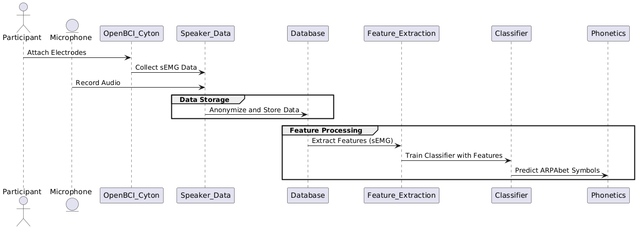
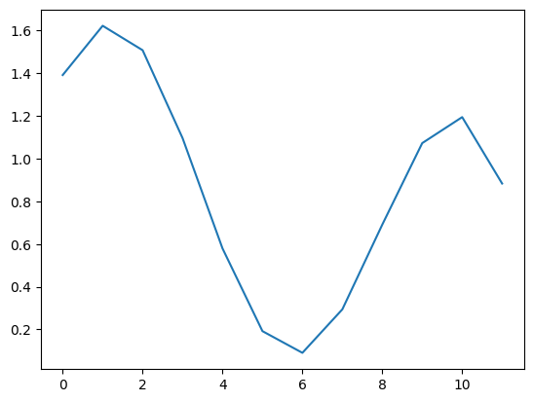
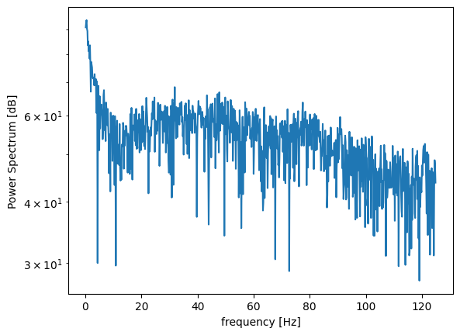
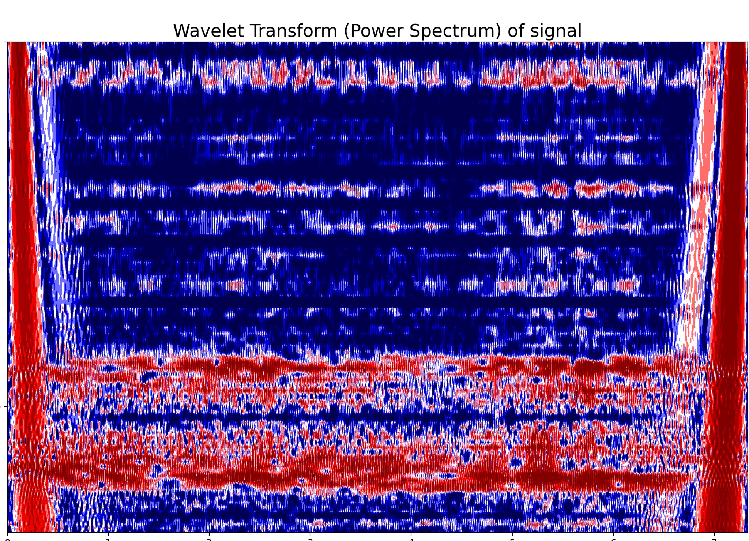
Notes:
Lucas

